Slide 1
WELCOME TO ASTON ADVISORY GROUP

Slide 3
Aston Advisory Group - Business Setup Made Easy
Aston Advisory Group is a company formation business assisting new and existing businesses to set up in Dubai. We deal with banking setup, company formation, and market analysis. We do this across a range of locations globally.

Slide 4
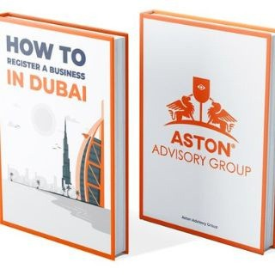
Aston Advisory Group Services
Business setup Corporate Banking Office Rentals Blogs

Slide 5
Business Setup
Focus on running your business, and let us handle the paperwork & Registration

Slide 6
Corporate Banking
No Corporate Taxes or income taxes allows for one hundred per cent Repatriation of funds

Slide 7
Office Rentals
Corporate workspace solutions and customized packages for your team
20% off When booking through Aston Advisory Group

