Slide 1
Equipments used in Brooding
M. Kamesh IV yr B. SC (Hons) Agriculture.,

Slide 2
Brooding equipment
Charcoal or kerosene stove
Hovers
Flat
Canopy
IR Bulbs
Brooder guards
Gas brooder
Electrical brooder

Slide 3
BROODING EQUIPMENT
Equipment used to provide warmth and light and to rear the baby chicks during the first few weeks of life are called brooders.
The brooders consist of some heating source, reflectors to reflect the heat and light towards the chicks, light and heat adjustment devices such as stands, thermostats and other accessories, depending on the model.
Different equipment used for brooding are,

Slide 4
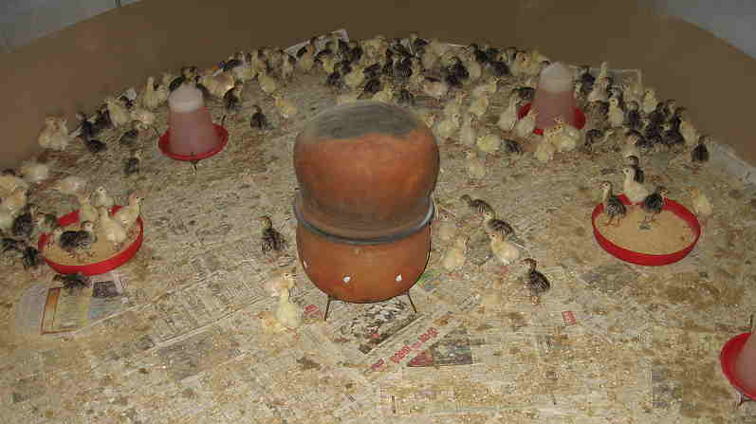
Charcoal or kerosene stove
These are used in places where electricity is not available or costly and where power failure is quite common.
These stoves are covered with plates or pans to sustain the heat in the brooding area.

Slide 5
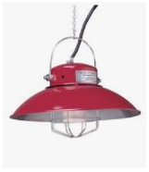
Hovers
These are reflectors of heat and light
Flat type hovers
These are flat in nature in which electrical bulbs are fitted.
Generally they are mounted with stands on all four corners, instead of hanging from the roof.
Canopy type hovers
This mechanism and thermometer.

Slide 6
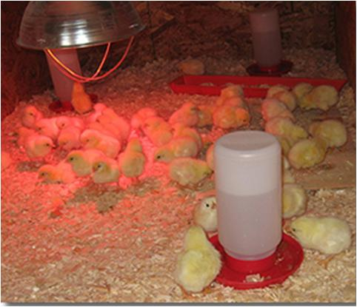
Infra-Red bulbs / self-reflecting bulbs
In general, IR bulbs are self reflecting bulbs and hence no need of reflector over the bulbs.
150 and 250 watt bulbs are available to provide sufficient heat to 150 and 250 chicks, respectively.

Slide 7
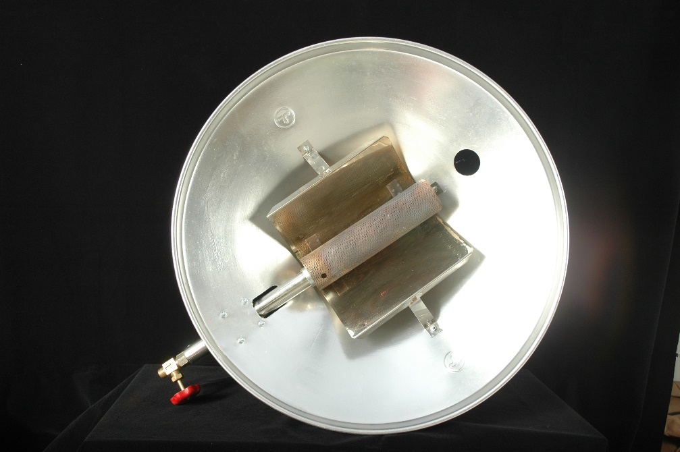
Gas brooder
In this heating element is connected with natural gas.
They are usually hanged 3-5’ above the chick level to provide heat.
It is attached with canopy type reflectors to reflect the heat towards the chicks.

Slide 8
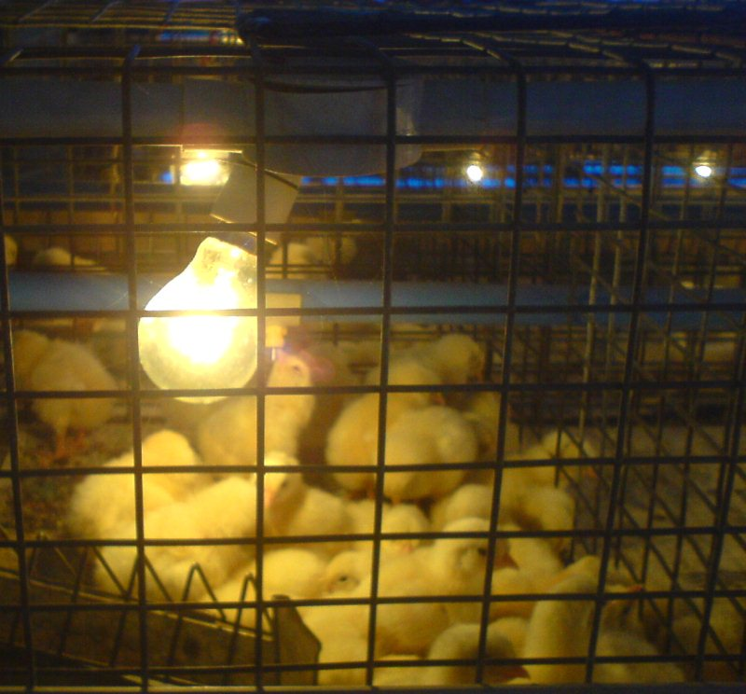
Electrical heaters (heating rods or coils)
This type of brooder is provided with heating elements and pilot lamps and in some cases thermometer is provided to record the temperature.
They used to have a reflecting device over the heating rods or coils.
The temperature can be adjusted depending on the requirement.

Slide 9
Thank you…

