Slide 1
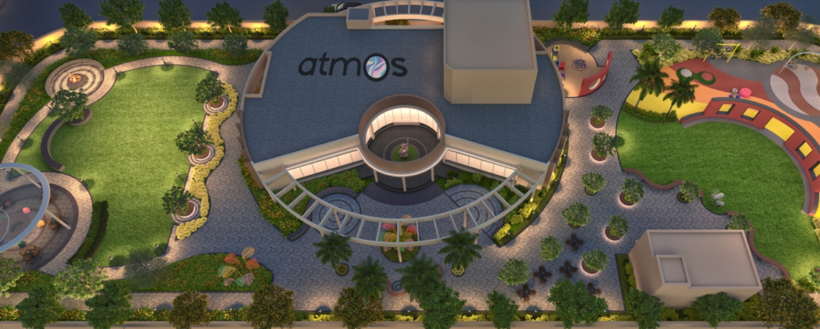
Kolte patil Life Republic Atmos

Slide 2
Amenities
Experience the epitome of luxury living at Kolte Patil Life Republic Aros, where an array of exquisite amenities awaits to elevate your lifestyle. Immerse yourself in unparalleled comfort with thoughtful features like a fully equipped gymnasium for your wellness needs, meticulous energy management, and meticulously landscaped surroundings.
At Kolte Patil Life Republic Aros Hinjawadi, we redefine modern living with a commitment to convenience. From closed car parking for added ease to a curated selection of amenities that seamlessly blend leisure and sophistication, every aspect of your lifestyle is addressed. Indulge in a harmonious living experience at Life Republic Aros, where comfort and luxury converge effortlessly.
Children's Play Zone
Outdoor Games
Swimming Pool Retreat:
Club House

Slide 3
Kolte Patil Developers
Kolte Patil Life Republic Atmos by Kolte Patil Developers stands out in the competitive real estate landscape through its illustrious track record over three decades. With a portfolio boasting over 50 projects encompassing residential complexes, commercial spaces, and IT parks, the company has established itself as a formidable player in the real estate sector. Covering a substantial saleable area of approximately 20 million square feet across key cities like Pune, Mumbai, and Bengaluru, Kolte Patil Developers Hinjewadi have consistently delivered quality and innovation.
The project distinguishes itself through its scale and meticulous attention to architectural innovation, sustainable living practices, and resident-centric design. This commitment to excellence places it in a league of its own compared to other developments, reaffirming its status as a premier choice for those seeking a distinctive and future-ready living experience in Hinjewadi.

