Slide 1
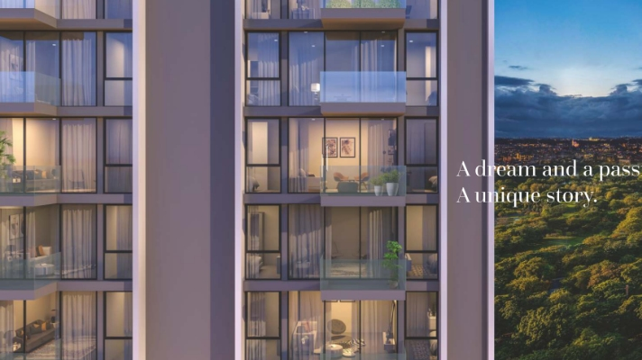
Kasturi Apostrophe: A Masterpiece in Real Estate

Slide 2
Prices
TYPE | PROJECT/PHASE NAME | TOWER | TOTAL CARPET AREA (SQ.M) | BASIC CARPET AREA (SQ.M) | TOTAL CARPET AREA (SQ.FT) | BASIC CARPET AREA (SQ.FT) | ALL INCLUSIVE PRICE (INR)
2 BHK | Tower C | 1 | 65.89 | On Request | 709.233 | 0.000 | 89 Lakhs*Onwards

Slide 3
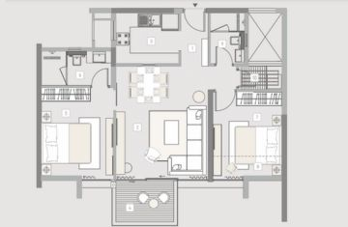
Floor Plan

Slide 4
Information:
Kasturi Apostrophe Hinjewadi Phase 3, Hinjewadi, Pune is an attraction to luxurious living and modern architecture. Kasturi Apostrophe, registered under RERA with the code P52100031595, guarantees openness and adherence to legal requirements.
Anticipated to be completed by December 2025, Kasturi Apostrophe Hinjewadi spans a generous total area of 6421 sq.m, occupying a sprawling 1.59 acres. The development comprises a single tower featuring 128 meticulously crafted units that epitomize the perfect blend of functionality and aesthetics. Is developed Kasturi Apostrophe by Kasturi Housing, a renowned real estate company known for its commitment to quality and innovation.
Whether you are a first-time homebuyer or an astute investor, Kasturi Apostrophe Hinjewadi Pune beckons with a promise of contemporary living in a strategically located hub. The meticulous planning and attention to detail showcased in this project make it a noteworthy addition to Pune's real estate landscape.

