Slide 1
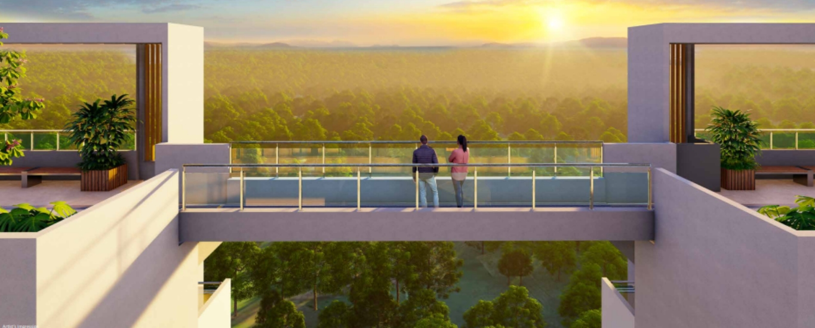
Kolte Patil Life Republic Aros

Slide 2
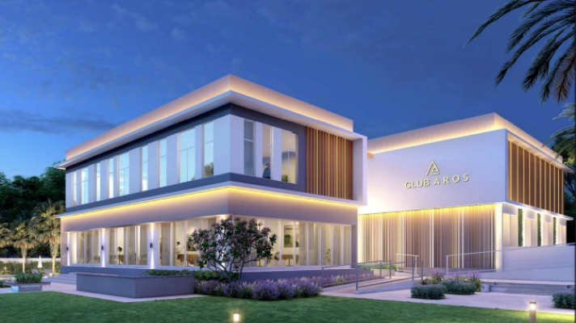
Club Àros

Slide 3
Location
Prime Location and Seamless Connectivity
Nestled in the prime location of Hinjewadi, spanning 2.27 acres with 688 units across five towers, Life Republic Aros is a RERA-registered society scheduled for possession in December 2026. With Ayushree Hospital as a notable landmark, enjoy seamless connectivity to Akurdi Railway Station and PCMC Metro Station.
Notes:
Lilfe republic aros

