Slide 1
Countdown to Price Increase: Save on Autodesk Before January 7th!
Authorized Autodesk Software Provider & Licenses

Slide 2
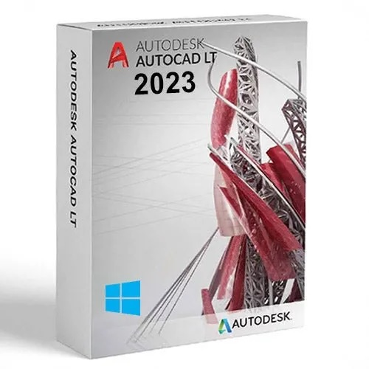
AutoCAD LT 2024 Commercial New Single-user ELD Annual Subscription
AutoCAD LT is a streamlined 2D drafting and documentation software designed for precision and productivity. Ideal for architects, engineers, and designers, it offers powerful drafting tools to create detailed 2D drawings with ease. Benefit from industry-standard workflows, collaboration tools, and enhanced performance in a cost-effective package.
Key Features:
2D drafting and design tools
Cloud-based collaboration capabilities
Intuitive user interface for streamlined workflows

Slide 3
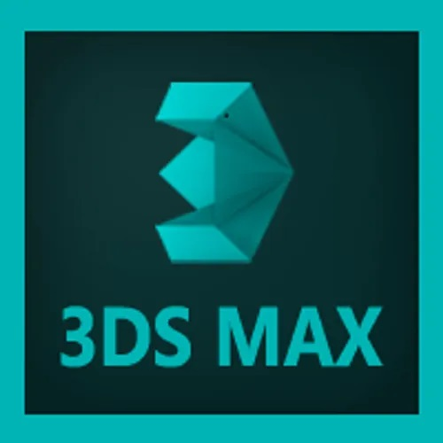
Autodesk 3DS MAX
3ds Max is a leading 3D modeling, rendering, and animation software tailored for game designers, architects, and visual effects artists. It empowers users to create immersive 3D worlds, stunning animations, and photorealistic visualizations with cutting-edge tools and high-end rendering capabilities.
Key Features:
Advanced 3D modeling and texturing
Realistic rendering with Arnold integration
Powerful animation and rigging tools

Slide 4
Autodesk Maya 2024
Autodesk Maya is an industry-standard software for 3D animation, modeling, simulation, and rendering, trusted by top film studios, game developers, and animators. Its robust toolset enables users to bring characters and environments to life with precision and creative control.
Key Features:
Powerful animation and rigging workflows
Realistic simulation tools (fluid, cloth, hair)
High-quality rendering with Arnold integration

Slide 5
Autodesk Media & Entertainment Software Collection
The Autodesk Media & Entertainment Collection provides a comprehensive suite of tools for 3D content creation, animation, and visual effects. Ideal for film, TV, and game production, this collection includes Maya, 3ds Max, and other specialized tools, enabling teams to create high-quality visuals and engaging experiences seamlessly.
Key Features:
Includes industry-leading tools like Maya and 3ds Max
Integrated workflows for 3D animation and VFX
Ideal for film, game, and television content creators

Slide 6
Thank You
We Look Forward to Your Questions and Feedback
Company Name: PI Software
Contact us: 9810080723
Email Address: supprt@pisoftware.in
Our Partners:

