Slide 1


Slide 2
Get a taste of happiness with choco filled candy-Bakemate-Eclairs
The choco-filled Éclair is a masterpiece of indulgence, featuring a delicately crisp outer shell that gives way to a soft, pastry-like interior. Each bite unveils a luscious, chocolate-filled center, offering a perfectly balanced and luxurious treat.
https://bakemate.in

Slide 3
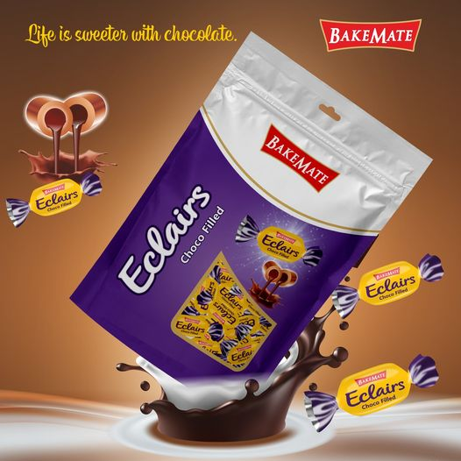

Slide 4
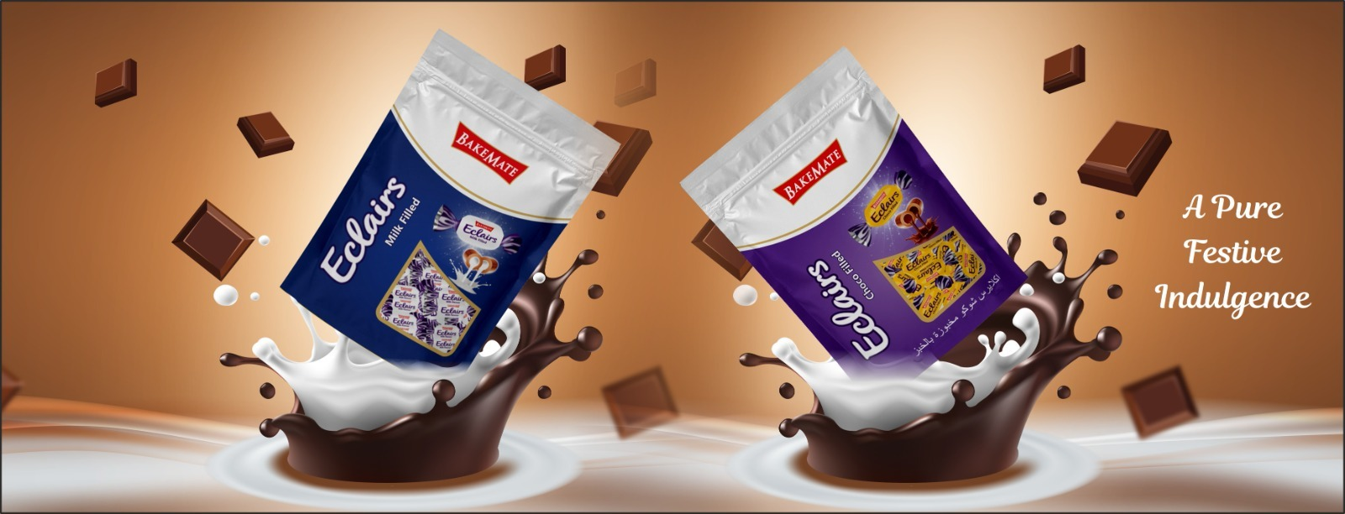

Slide 5
Éclairs candy is a delightful treat enjoyed worldwide for its rich, creamy flavor and chewy texture. While éclairs candy is primarily consumed for pleasure rather than health benefits, here are some potential advantages:
1. Quick Energy Boost
Éclairs candy contains sugar, which provides a quick source of energy. This makes it a handy pick-me-up for moments of low energy.
2. Mood Enhancer
The sweet taste and creamy filling can trigger the release of endorphins, which are chemicals in the brain that promote feelings of happiness and well-being.
3. Compact and Convenient
Éclairs candies are small, portable, and individually wrapped, making them easy to carry and share.
4. Social and Cultural Bonding
Sharing éclairs can foster social interactions, whether during a celebration, casual gathering, or as a small gift.
5. Variety of Flavors
Available in various flavors (e.g., chocolate, caramel, fruit), éclairs cater to diverse taste preferences.
6. Source of Comfort
For some, éclairs candy serves as a nostalgic comfort food, evoking pleasant memories of childhood or special occasions.
7. Customization Potential
Éclairs can be used creatively in desserts, from candy-based decorations to ingredients in baked goods.
Chocolate Manufactures|Bakemate|Largest Chocolate Manufactures In India|Biscuit Manufactures|Candies|Global Chocolate Manufactures|

Slide 6
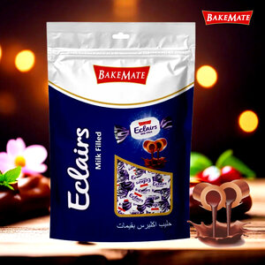

Slide 7
Thank You

