Slide 1


Slide 2
The perfect crunch for your chocolate cravings-Snap IT
Delight in the irresistible charm of Snap It, a chocolate bar that masterfully blends crunchy, chocolate-coated goodness with a light, crispy wafer. Crafted for true chocolate enthusiasts, this delectable treat offers the perfect balance of texture and flavor in every satisfying snap. Whether you’re savoring it on the go or indulging during a moment of relaxation, Snap It promises an unforgettable chocolate experience that’s simply irresistible.
https://bakemate.in

Slide 3
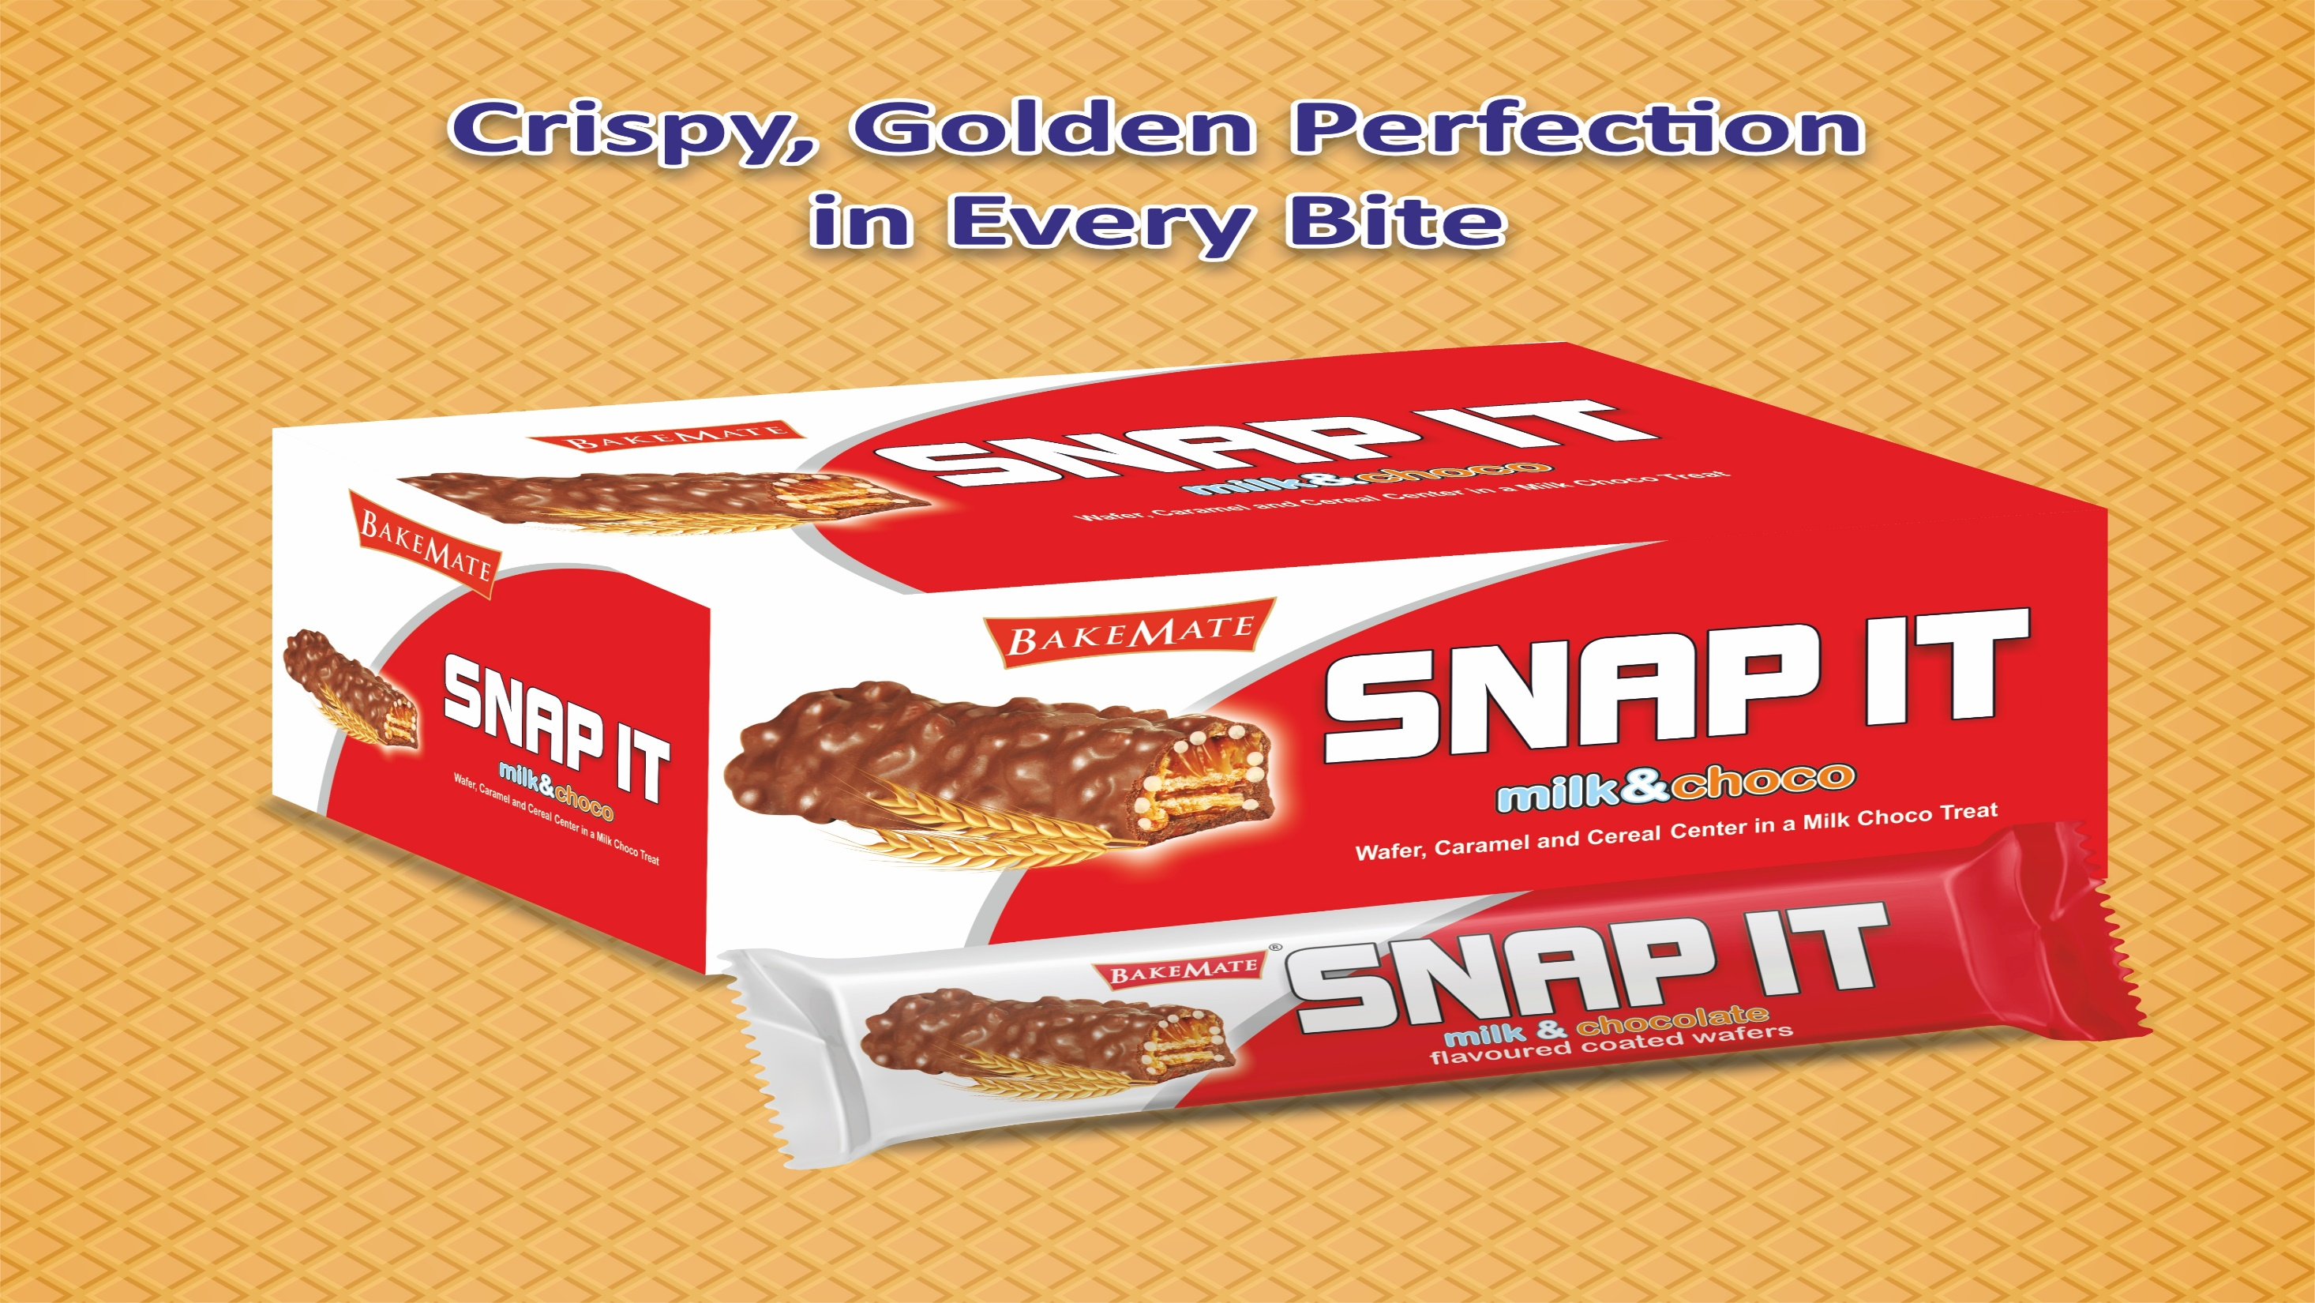

Slide 4
Benefits of Snap It Chocolate Bar
1.Perfect Texture Combination
Snap It offers a delightful mix of creamy chocolate and crispy wafer, providing a satisfying crunch in every bite. This balance of textures enhances the overall eating experience.
2. Quick Energy Boost
The natural sugars and carbohydrates in Snap It make it an excellent source of quick energy, perfect for a midday snack or an on-the-go treat.
3. Mood Enhancer
Chocolate is known to stimulate the release of endorphins and serotonin, which can help improve mood, reduce stress, and provide a sense of happiness.
4. Lightweight and Portable
Snap It is designed to be conveniently portable, making it easy to carry in your bag, lunchbox, or pocket for a treat wherever you are.
5. Shareable Design
The segmented "snap" design makes it simple to break and share with friends and family, promoting social bonding and mindful snacking.
6. High-Quality Ingredients
Crafted with premium chocolate and quality wafers, Snap It ensures a superior taste that meets the expectations of chocolate lovers.
7. Versatility
Enjoy Snap It as a standalone treat, use it as a topping for desserts, or pair it with coffee, milk, or tea for an enhanced experience.
8. Kid-Friendly Appeal
With its fun, snappable design and delicious taste, Snap It is a favorite among children, making it a great addition to lunchboxes or party treats.
9. Indulgent Yet Balanced
The lightness of the wafer balances the richness of the chocolate, making it an indulgence that doesn’t feel overly heavy or excessive.
10. Satisfaction Guaranteed
Snap It is crafted to deliver a consistent and satisfying experience in every bar, making it the ultimate choice for chocolate enthusiasts.
Chocolate Manufactures|Bakemate|Largest Chocolate Manufactures|Biscuit Manufactures|Candies|Global Chocolate Manufactures|

Slide 5


Slide 6
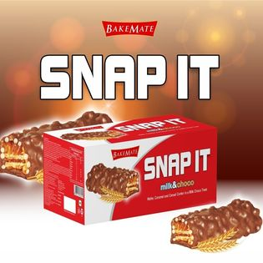

Slide 7
Thank You

