Slide 1


Slide 2
Enjoy a perfect sweet treat –Bakemate BRO POP
Dive into a world of flavor with our Choco Cookie Lollipops—an irresistible combination of luscious chocolate filling encased in a golden, crispy cookie shell. Perfectly portioned and designed for a mess-free treat, these delightful lollipops are a hit with kids and adults alike, making them ideal for snacking at home, on the go, or sharing with friends. Crafted from the finest ingredients, every lollipop is packed with the richness of smooth chocolate and the crunch of cookies, delivering a taste that’s nothing short of perfection. Whether it’s a quick pick-me-up or a sweet indulgence, BRO POP has you covered!
https://bakemate.in

Slide 3
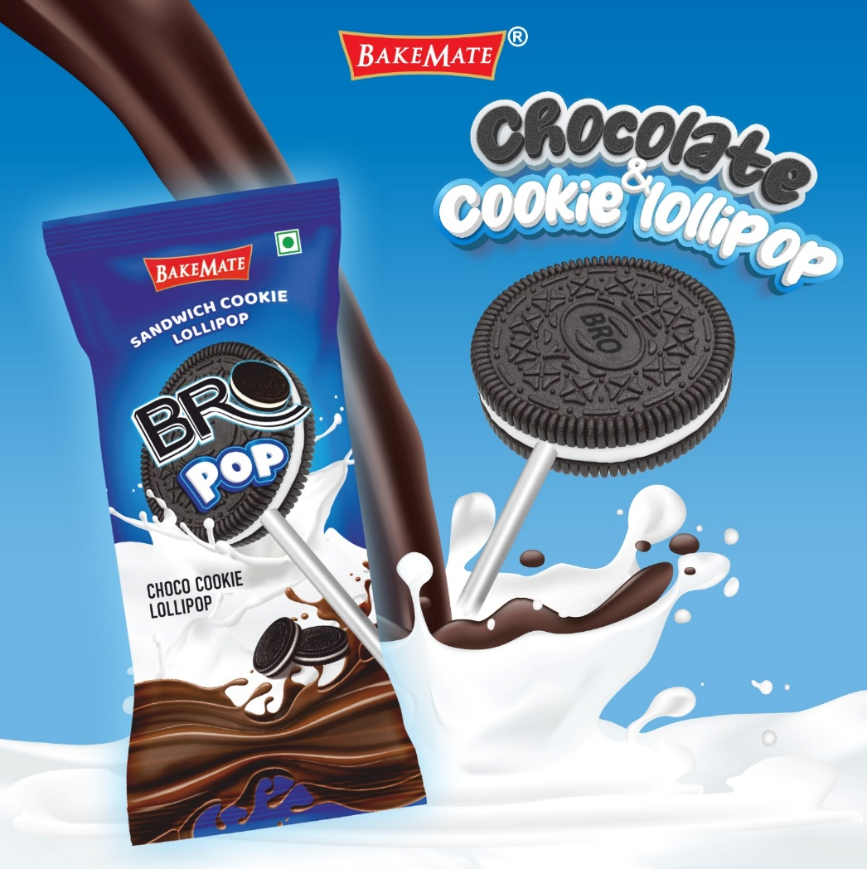

Slide 4
The Bro Pop Choco Cookie Lollipop likely offers several benefits that make it an appealing product for consumers. Here are some potential benefits based on its features and market positioning:
1. Delicious and Unique Treat
Combines the rich flavors of chocolate and cookies in a fun lollipop format, making it a delightful snack for all age groups.
2. Convenient and Portable
Individually wrapped, making it easy to carry, share, or enjoy on the go.
3. Fun and Engaging for Kids
The lollipop format is a hit among children, adding an element of fun and play while snacking.
4. Sweet Tooth Satisfaction
Perfect for those who crave a combination of chocolate and cookies, offering a satisfying indulgence.
5. Portion-Controlled Snack
The lollipop size ensures a controlled portion, helping to avoid overeating while still enjoying a sweet treat.
6. Visually Appealing
Its attractive design and presentation make it suitable for gifting or as a party treat.
7. Versatility
Ideal for various occasions, such as birthdays, festivals, or as part of festive hampers.
8. Premium Ingredients
If crafted with high-quality chocolate and cookies, it emphasizes superior taste and quality, aligning with BakeMate’s reputation for excellent.
Chocolate Manufactures|Bakemate|LargestChocolateManufactures|Lollipops|Bropop|Candies|Biscuit Manufactures|Cream Biscuits|Chocolates|Global Chocolate Manufactures

Slide 5
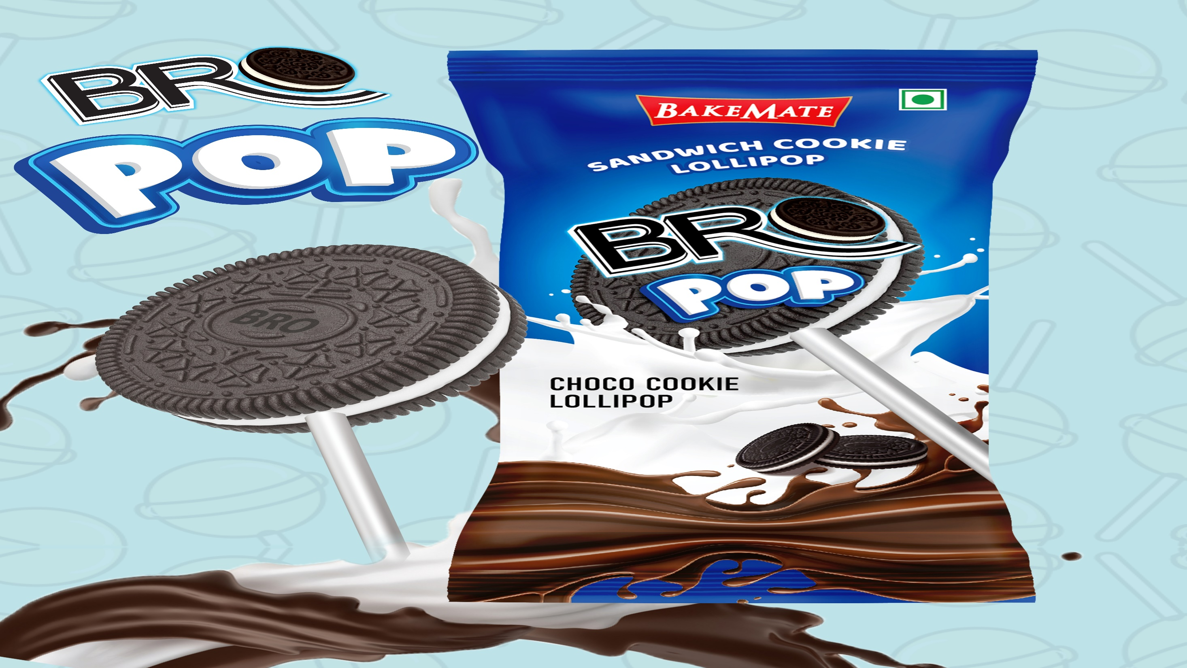

Slide 6
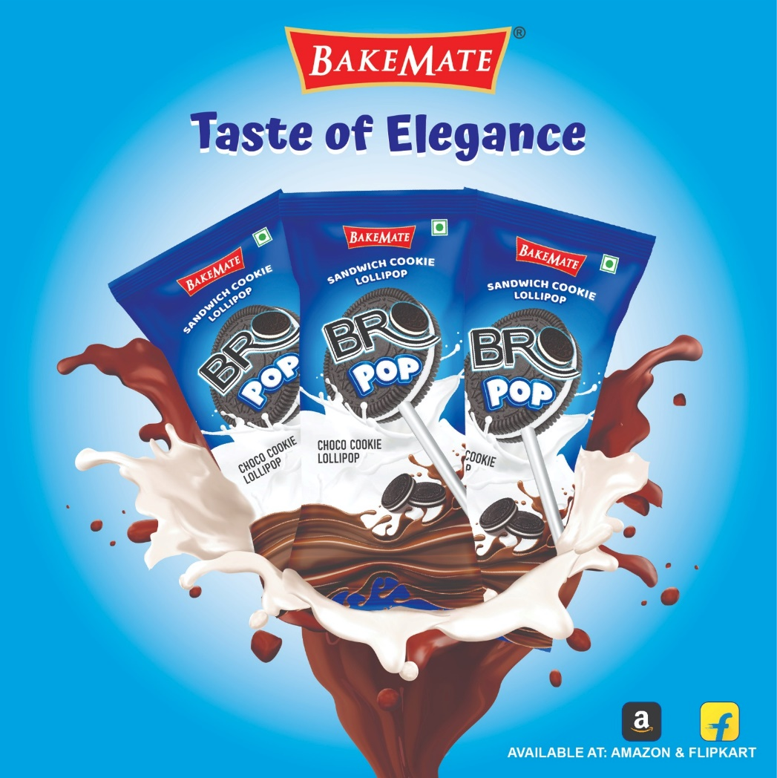

Slide 7
Thank You

