Slide 1


Slide 2
The Perfect Crunch in Every Munch-Roasted Nuts
At Unwrap Happiness, we take pride in creating exquisite treats that celebrate India's rich heritage while delighting taste buds across the globe. Our expert artisans seamlessly blend tradition with innovation, crafting confections that go beyond ingredients to deliver an unforgettable experience. By selecting the finest cocoa, purest teas, and crunchiest nuts, we ensure that every bite is a tribute to excellence. Thoughtfully curated and elegantly packaged, our hampers make the perfect gift for any occasion—be it festive celebrations, corporate gestures, or heartfelt surprises.
https://www.unwraphappiness.in

Slide 3
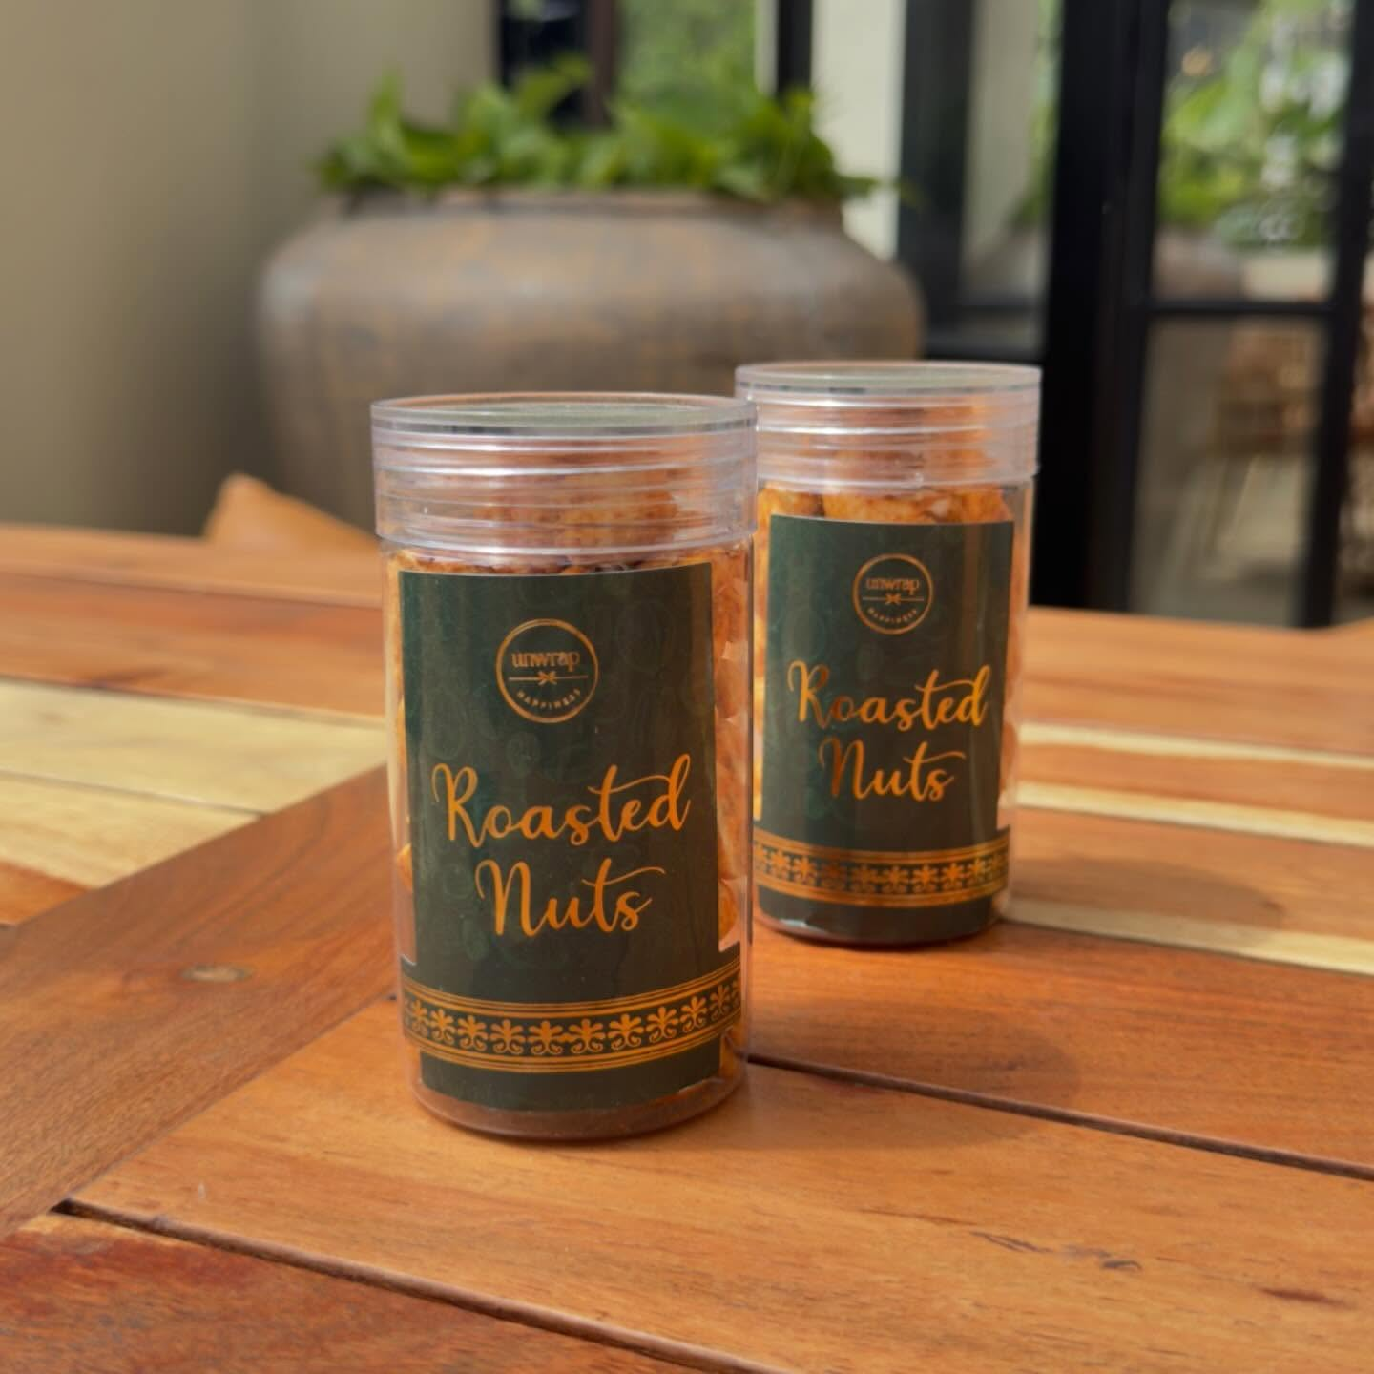

Slide 4
Roasted nuts offer a delicious and nutritious snack with numerous health benefits. Here are some key advantages:
1. Rich in Nutrients
Packed with protein, healthy fats, fiber, vitamins, and minerals.
High in essential nutrients like magnesium, potassium, and vitamin E.
2. Supports Heart Health
Contains healthy monounsaturated and polyunsaturated fats that help reduce bad cholesterol (LDL).
Rich in antioxidants, which protect the heart and reduce inflammation.
3. Boosts Energy Levels
A great source of healthy fats and protein, providing sustained energy.
Ideal for pre- or post-workout snacks.
4. Aids in Weight Management
High in fiber and protein, keeping you full for longer and reducing cravings.
Supports metabolism and healthy digestion.
5. Promotes Brain Health
Rich in omega-3 fatty acids and vitamin E, which improve cognitive function.
Helps reduce the risk of neurodegenerative diseases like Alzheimer's.
6. Supports Immune System
Loaded with antioxidants, zinc, and selenium that boost immunity.
Helps combat oxidative stress and inflammation.
7. Good for Skin & Hair
Vitamin E and healthy fats nourish the skin and promote hair growth.
Helps maintain a youthful glow and prevents dryness.
8. Convenient & Versatile Snack
Easy to carry and enjoy anywhere—perfect for on-the-go snacking.
Can be added to salads, smoothies, desserts, and more.
Gift Hampers|Chocolate Gift Hampers|Cookies Gift Hampers|Unwrap|Dryfruits|Herbal Tea|Wedding Gift Hampers|Festival Gift Hampers|Wafers Gift Hampers|

Slide 5
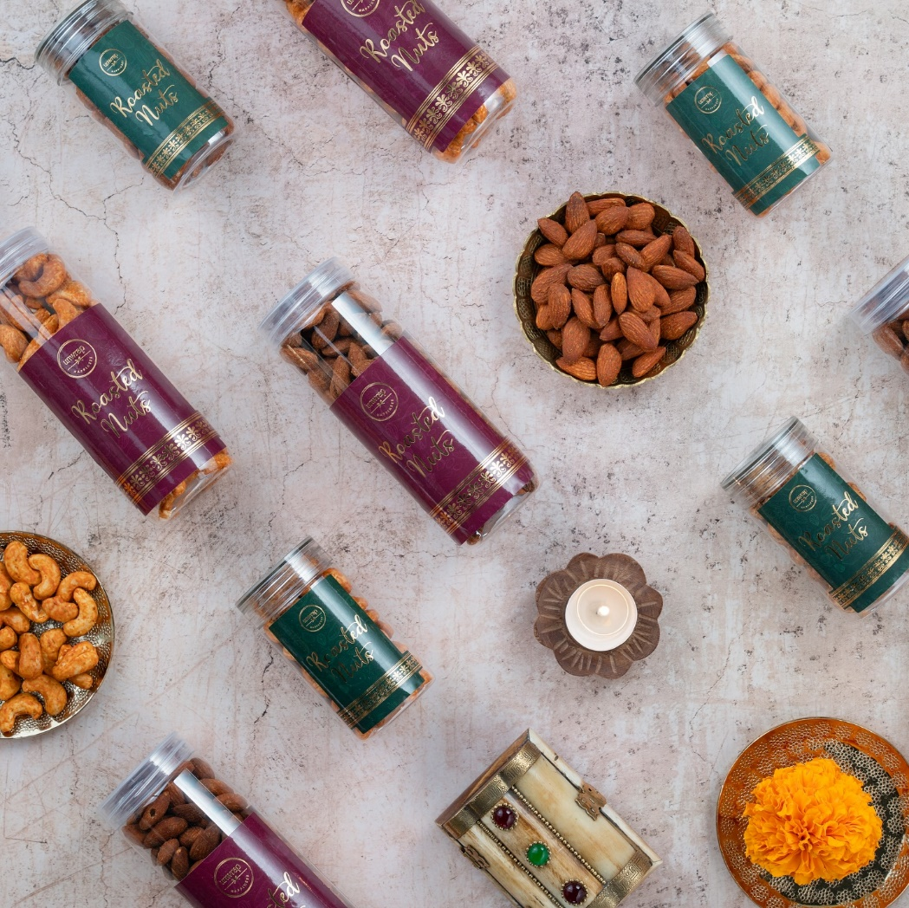

Slide 6
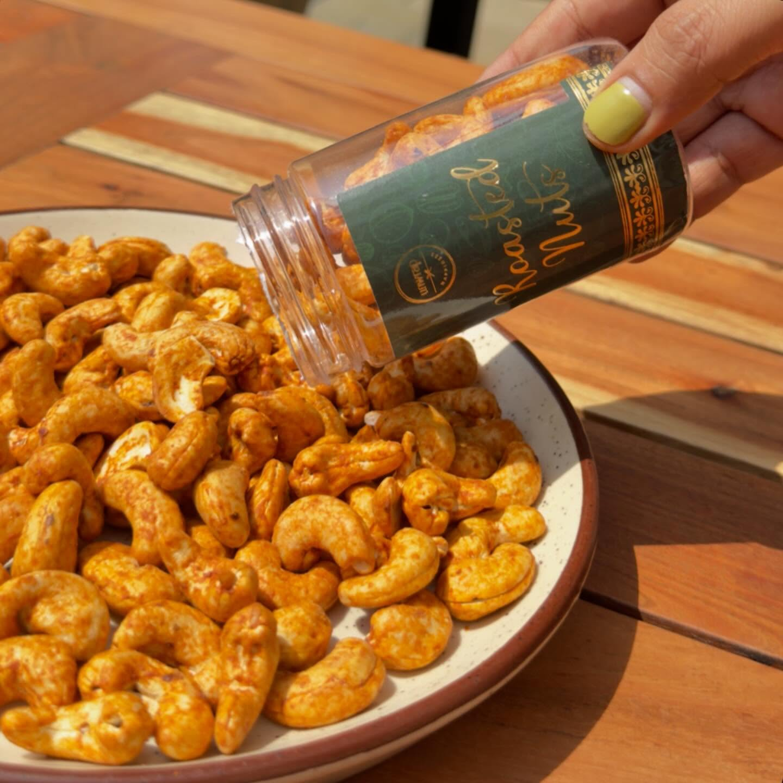

Slide 7
Thank You

