Slide 1


Slide 2
Refresh Your Taste Buds with Every Bite-C-Vita Candy
Experience a burst of citrus bliss with Bakemate C Vita Orange Candy! Infused with the vibrant essence of fresh oranges, each piece delivers a perfect balance of sweet and tangy flavors that refresh your senses with every bite.
More than just a treat, Bakemate C Vita is a delightful indulgence for any moment. Whether you're craving a quick energy boost, a flavorful snack to share, or simply a refreshing taste of orange goodness, these candies are your perfect companion for a zesty and satisfying experience!
https://bakemate.in

Slide 3
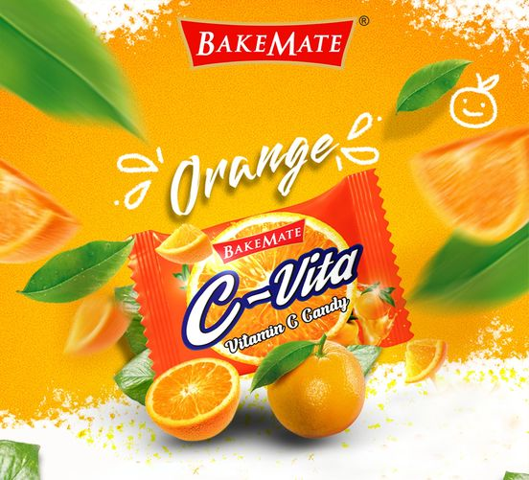

Slide 4
.
Benefits of Orange Candy 🍊🍬
Delicious & Refreshing Flavor – The sweet and tangy taste of orange candy offers a refreshing burst of citrus goodness.
Instant Energy Boost ⚡ – The sugar content provides a quick source of energy, making it a great pick-me-up during the day.
Mood Uplifter 😊 – Citrus flavors are known to enhance mood and reduce stress, leaving you feeling refreshed and happy.
Aids Digestion 🌿 – The tangy taste stimulates saliva production, which can help with digestion and prevent dry mouth.
Portable & convenient 🎒 – individually wrapped and easy to carry, orange candies are a perfect treat for travel, work, or school.
Satisfies sweet cravings 🍬 – a small yet satisfying treat to curb sugar cravings without overindulging.
May soothe sore throat 🏥 – the citrus essence can provide a soothing effect for minor throat irritations.
Great for freshening breath 🍊 – the zesty flavor leaves a pleasant aftertaste, keeping your breath feeling fresh.
Kid & family-friendly 👨‍👩‍👧 – a universally loved candy that’s enjoyed by both kids and adults.
Fun & versatile 🎉 – can be enjoyed as a simple treat, used in desserts, or even added to beverages for an extra citrusy twist
Chocolate Manufactures|Bakemate|Largest Chocolate Manufactures|C-Vita Candy|Lollipops|Candies|Biscuit Manufactures|Wafers|Chocolates|Global Chocolate Export|

Slide 5
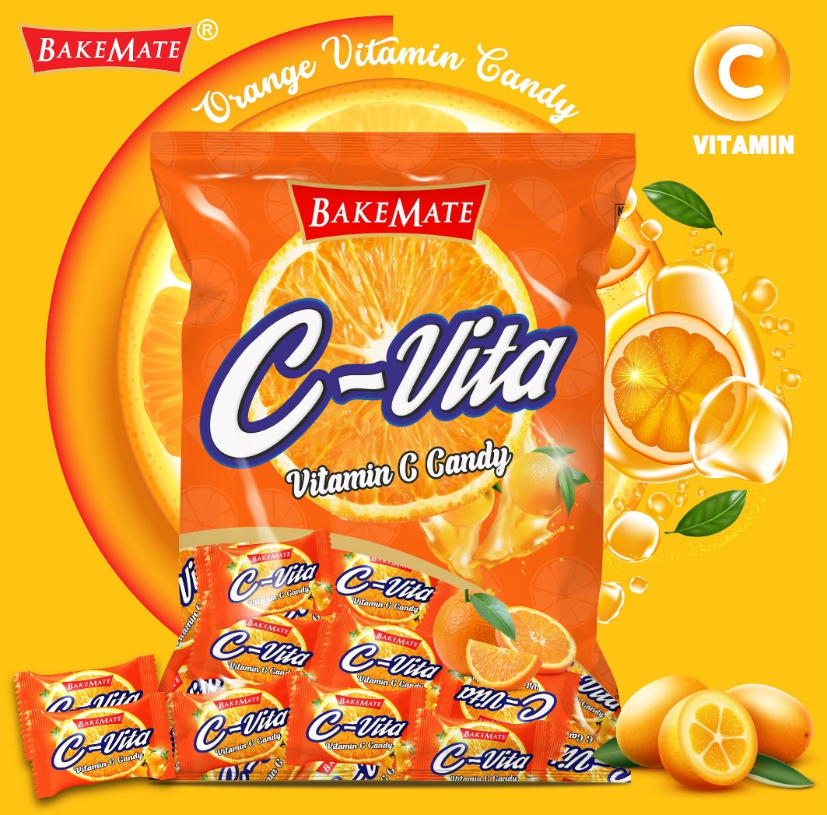

Slide 6
Thank You

